Slide 1

DLCV PROJECT
TOPIC: Reading captchas using OCR
SUBMITTED BY:
NAMIT KAPOOR-21UCS135
SUBMITTED TO:
PROF. INDRADEEP MASTAN
Notes:
1

Slide 2

1
Description:
We have developed a strong Deep Learning OCR (Optical Character Recoginition) Model to address the problem of reading Captchas on a variety of platforms and formats. Using sophisticated Convolutional Neural Networks (CNNs) and recurrent architectures, this model is quite good at correctly extracting text from Captcha photos, even ones with complicated backgrounds, varied typefaces, fancy fonts and elaborate distortions.
2
Purpose:
The purpose of our OCR Model for reading Captchas is to automate the process of decoding these security measures in order to differentiate between human users and automated bots. Using sophisticated neural network architectures and training algorithms, the model aims to properly read the distorted text within Captchas, thereby improving the security of online systems by blocking unauthorized access and delivering a smoother user experience for real users.
Notes:
2

Slide 3
Data Set Description
Image Variety: The dataset encompasses a wide variety of CAPTCHA images. In this dataset, there are 1040 samples are used and they are in Greyscale but be aware that they still have 3Dimensions, featuring diverse fonts, sizes, and styles of distorted text. This variety mimics real-world CAPTCHA scenarios encountered on various online platforms.
1
2
Synthetic Generation: This collection contains photos that have been artificially altered to include noise, rotation, occlusion, and different backgrounds. For CAPTCHA identification tasks, our synthetic generation approach guarantees a hard and varied sample.
Each CAPTCHA image is associated with a corresponding label indicating the correct sequence of characters within the CAPTCHA
The number of unique characters found in the data set is: 19
Different Characters that are used in these sample captchas are :
['2', '3', '4', '5', '6', '7', '8', 'b', 'c', 'd', 'e', 'f', 'g', 'm', 'n', 'p', 'w', 'x', 'y']
Maximum length of the captcha that would be processed: 5
3

Slide 4

Character Segmentation Based Approach
We first attempted to approach this problem using CNNs.
Segmentation: refers to the process of breaking the whole image into subparts for further process.
OCR Segmentation: is breaking the image that contains text into small parts to recognize the text form the background, and it is done through several steps.
Input Text Image
A digital image that contains Text or scanning some documents by Scanner and storing it as a digital image
Pre-processing
Grey Scale Conversion
Binarizing Image
Morphological Operation
Dilation
Erosion
Segmentation
This stage involves in three steps:
Line Level Segmentation
Word Level Segmentation
Character Level Segmentation
Notes:
3

Slide 5
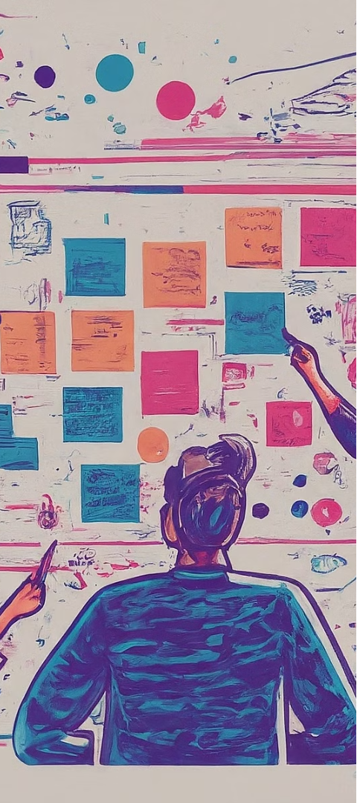
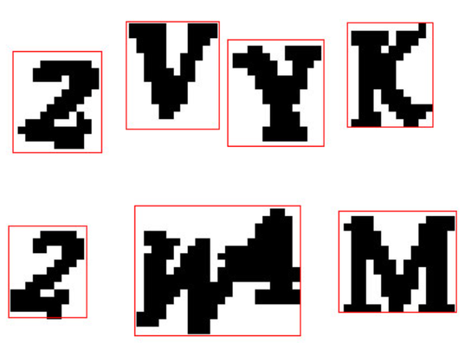
Limitations of the Character Segmentation Approach
1
Time-Intensive Processing
2
Economically Unfeasible Approach
Character segmentation requires substantial computational time which can impede the efficiency of OCR models.
Character segmentation entails algorithmic complexity which requires great computational power, and leads to increased operational expenses.
Impracticality in Many Instances
3
Sometimes, trying to split letters in pictures just doesn't work well. It's tricky and can lead to mistakes, especially with messy handwriting or fancy fonts.
For example, in this image character segmentation is not done properly
Notes:
4

Slide 6

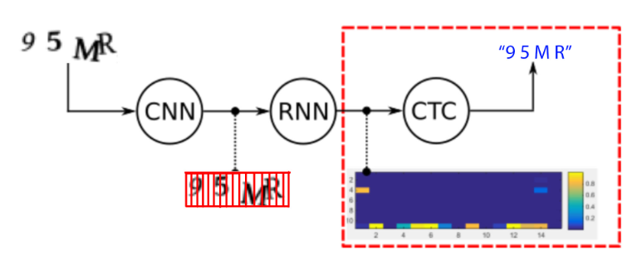
Convolutional Recurrent Neural Network with CTC loss (Connectionist Temporal Classification) :
A Better Solution
Why Convulational and Recurrent Neural Network in OCR?
Optical Character Recognition (OCR) refers to handwritten or printed text in a wide range of backgrounds (e.g., documents, photos of documents, and other background scenes) stored digitally. The OCR data is text in the vision format, which succeeds the feature of text data. Convolutional Neural Networks (CNNs) are excellent at extracting spatial features from images, and) Recurrent Neural Networks (RNNs) are proficient in modeling sequential data. By combining CNNs for feature extraction and RNNs for sequence modeling, CRNs can effectively handle the challenges of OCR tasks.
Notes:
5

Slide 7

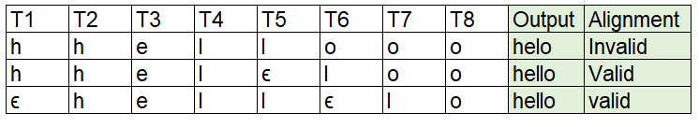
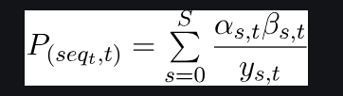
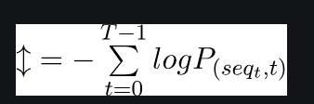
What is Connectionist Temporal Classification:
Connectionist temporal classification (CTC) is a type of neural network output and associated scoring function for training recurrent neural networks (RNNs), such as LSTM networks, to tackle sequence problems where the timing is variable.
It operates over time steps, predicting a probability distribution over labels for each time step.
Time Series Bases Classification is done, not Traditional classification
Alignment Algorithm
There are two issues in alignment:
Output text taking more than one-time step.
Repeating characters
Loss Calculation
To calculate the loss, we must calculate the probability of generating the output sequence.
To calculate CTC loss, we must modify the input sequence to include blank symbols between each pair of characters.
Thus, an input word [‘ h e l l o’] is modified to [‘ϵ h ϵ e ϵ l ϵ l ϵ o ϵ’]
Each character in the modified sequence is known as a state represented by (s). The CTC algorithm calculates two variables at each time stamp: Forward variable α(s, t) and Backward variable β(s, t)
This forward-backward algorithm ‘calculates the probability of generating the required output at each step.
The model will output the probability of each token in the vocabulary y (s, t) at each time stamp
Notes:
6

Slide 8

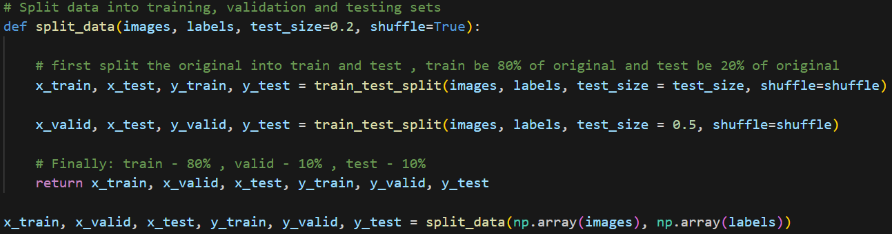
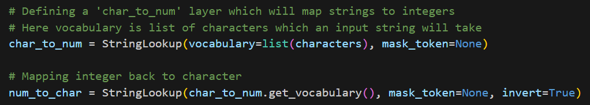
Implementation
Part 1: Pre-Processing the Dataset
Splitting the dataset into training, validation, and testing sets
train - 80%, valid - 10%, and test - 10% of the original dataset
Mapping of each character of the string (labels) to an integer for training the model
and also Integers to string for prediction of the text in captcha image
Char_to_num.get_vocabulary() –
['[UNK]', '2', '3', '4', '5', '6', '7', '8', 'b', 'c', 'd', 'e', 'f', 'g', 'm', 'n', 'p', 'w', 'x', 'y']
Notes:
10

Slide 9
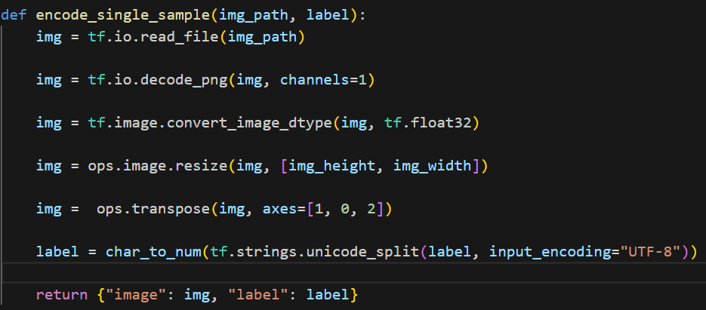
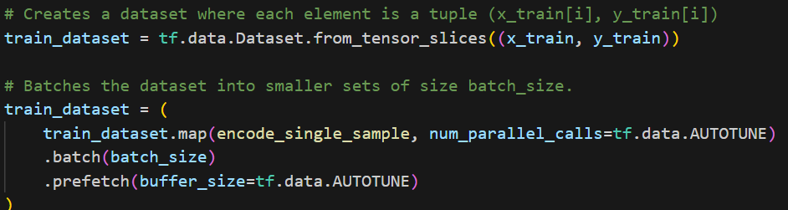
Part 1: Pre-Processing the Dataset
Img_height = 50, img_width = 200
Creating the Dataset Objects (train_dataset,validation_dataset,test_dataset)
A Tensorflow dataset from two tensors. ‘image’ and ‘label,’ where each dataset element is a tuple containing corresponding elements from ‘image’ and ‘label.’
Then, our Tenserflow ‘dataset’ goes through a series of transformations.
Each tuple in the dataset is encoded with the help of the ‘encode_single_sample’ function,
Finally, the dataset is divided into multiple batches where the batch size is 16
Notes:
10

Slide 10
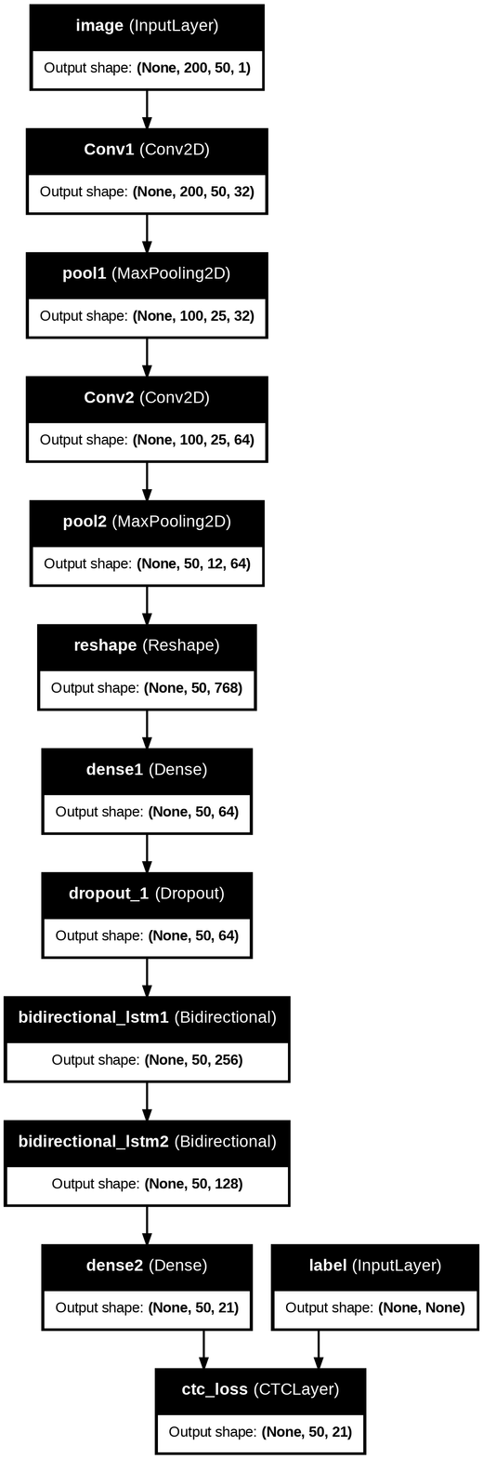
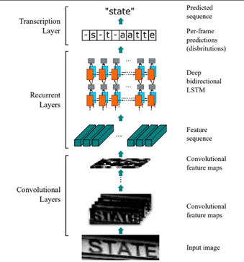
Part2: Creating our Model CRNN with CTC Loss
Architecture:
Convolutional Layers: Two sets of convolutional layers with ReLU activation, 32 filters each, 3x3 filter size, followed by max pooling with stride 2, then 64 filters with the same configuration.
Reshaping: After the convolutional layers, the image is reshaped to (50, 768).
Fully Connected Layer: Followed by a fully connected layer with ReLU activation and a dropout layer (p=0.2).
Bidirectional LSTMs: Feature sequence passed through bidirectional LSTMs.
Dense FC Layer: Final layer with neurons equal to vocabulary length + 1, with softmax function is used.
CTC Layer: Output and labels passed to CTCLayer for CTC loss calculation.
Notes:
11

Slide 11
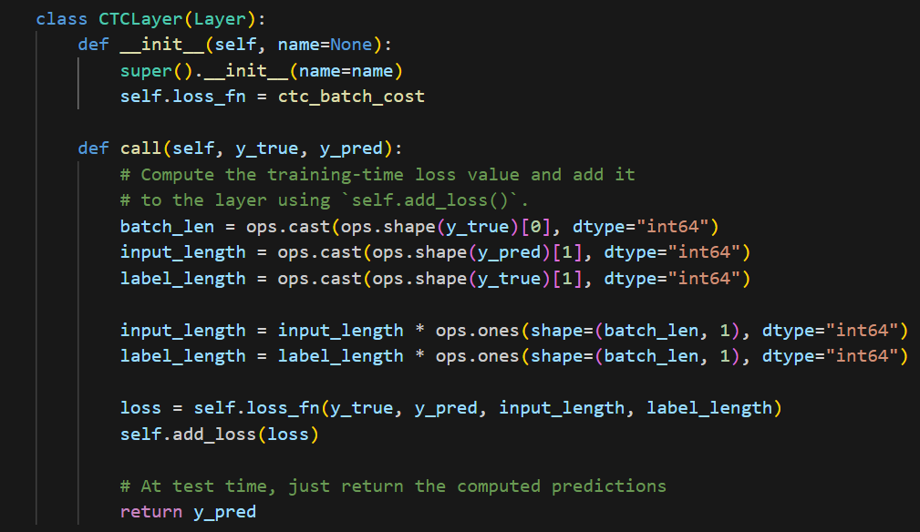
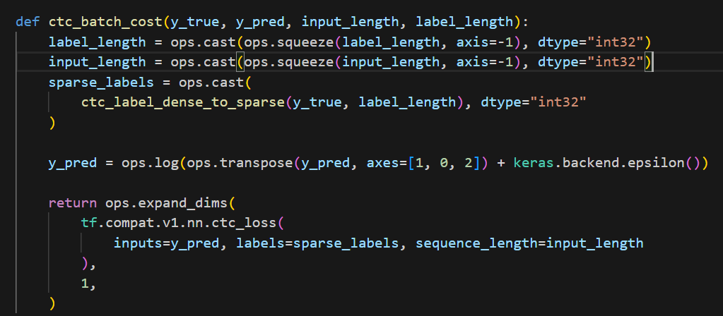
Part2: Creating our Model CRNN with CTC Loss
A custom layer named ‘CTCLayer’ is defined to compute CTC loss during model training.
ctc_batch_cost computes CTC loss for a batch of data and also Handles label conversion and loss calculation.
ctc_label_dense_to_sparse Converts dense label representations to sparse format.
ctc_batch_cost
Computes the CTC (Connectionist Temporal Classification) loss for a batch of data.
Steps:
Input Preparation
Label Transformation (sparse to dense)
Logits Transformation (Transpose)
CTC Loss Calculation
Notes:
11

Slide 12
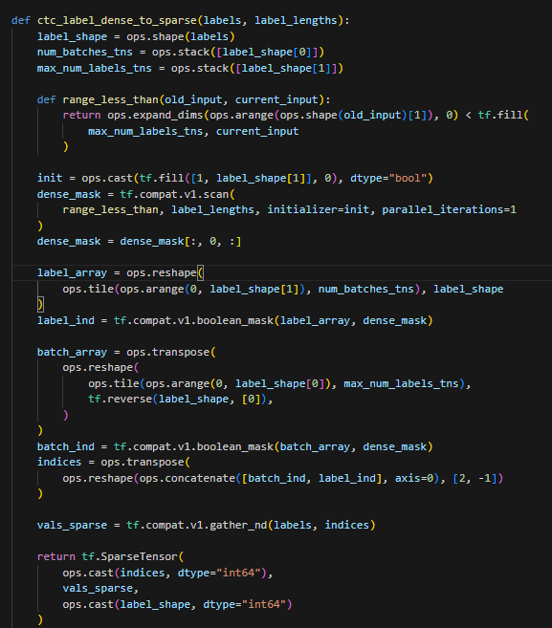
Part2: Creating our Model CRNN with CTC Loss
ctc_label_dense_to_sparse
Dense labels refer to a representation where each element in the label sequence corresponds to a specific time step or position
Sparse labels represent sequences with variable lengths more efficiently. Instead of explicitly representing every element in the sequence, sparse labels store only the non-zero elements and their corresponding indices.
Converts dense label representations to sparse representations required for CTC loss calculation.
Steps:
Label Transformation
Creating a Dense Mask
Index Calculation
Constructing Sparse tensor
Notes:
11

Slide 13

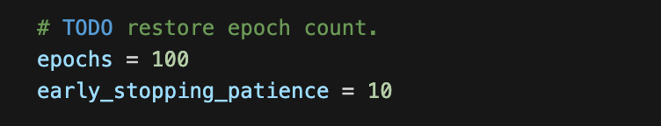
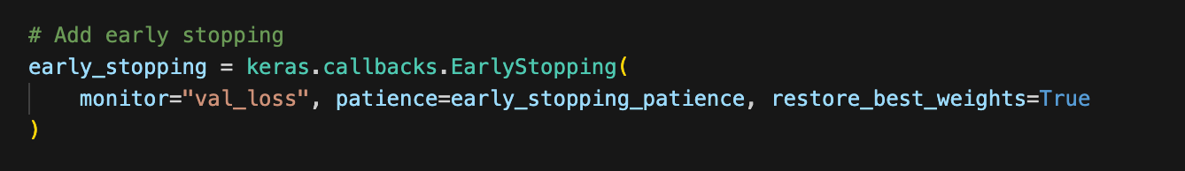
Part3: Model Training
EPOCHS : This means that the entire training dataset will be passed through the model 100 times. Each pass through the dataset allows the model to learn more about the features and improve its accuracy.
EARLY STOPPING PATIENCE: If the validation loss does not improve until 10 more epochs, then the training IN Early stopping will stop early to save cost and avoid overfitting
MONITOR: keeps an eye on validation loss
RESTORE BEST WEIGHTS: When training is stopped early, this option ensures that the model's weights are rolled back to where it performed the best on the validation loss.
Notes:
13

Slide 14
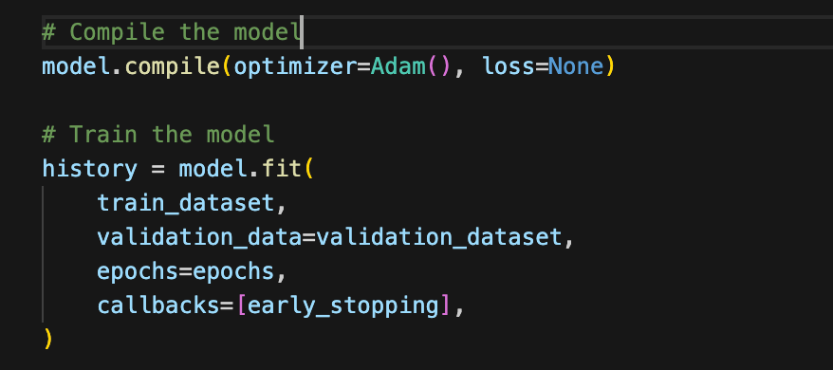
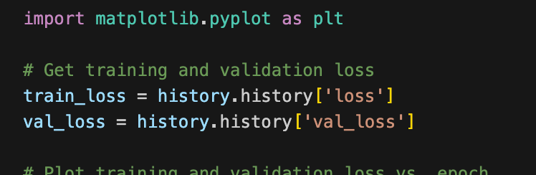
ADAM OPTIMISER is a popular optimizer used in training neural networks; it adjusts the weights of the model to minimize the loss.
LOSS is calculated during model building itself, because we added CTC layer in architecture which calculated loss as well as predicted output.
TRAIN_LOSS stores the loss on the training dataset after each epoch, while VAL_LOSS stores the loss on the validation dataset after each epoch in the history variable.
Notes:
13

Slide 15

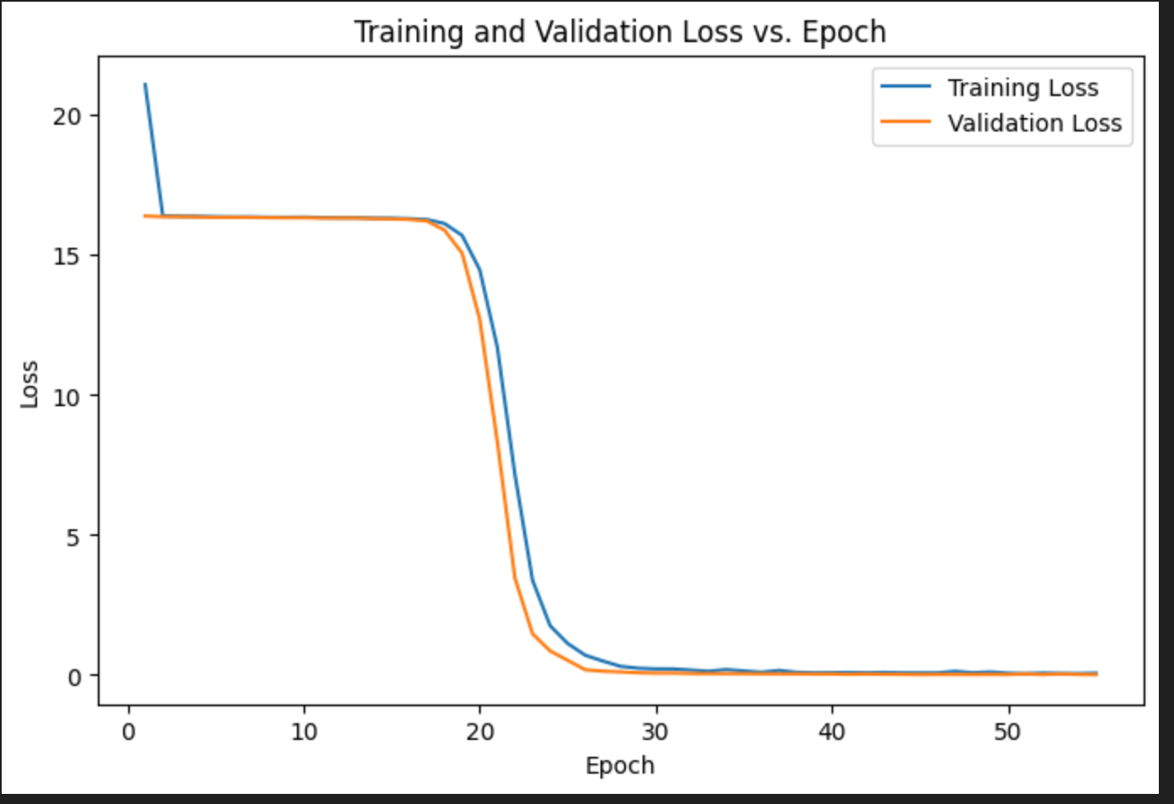
we run the code till epoch 45, because after 45 till 10 more epochs (early_stopping_patience = 10) i.e. epoch number 45 to epoch number 55 the validation loss keeps fluctuating but its value does not become less than 0.0161
Notes:
14

Slide 16
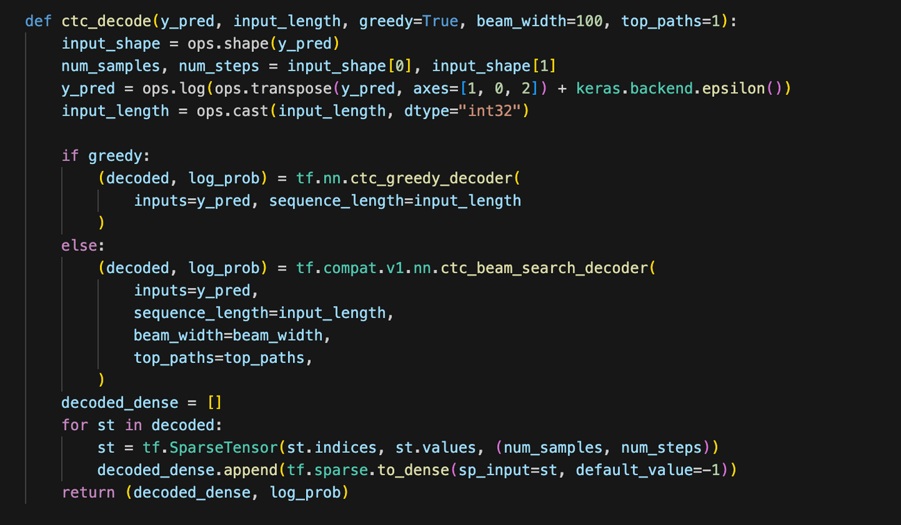
part4 : Model Inference
DECODING
1. If greedy is True, the function uses the greedy decoder (ctc_greedy_decoder), which simply picks the most probable next step at each timestep.
2. If greedy is False, the beam search decoder (ctc_beam_search_decoder) considers multiple possible sequences simultaneously, keeping track of the beam_width most probable options.
default_value=-1 indicates that all positions not explicitly filled in the sparse tensor will be filled with -1 in the dense tensor because ctc decoders give sparse outputs
Notes:
14

Slide 17
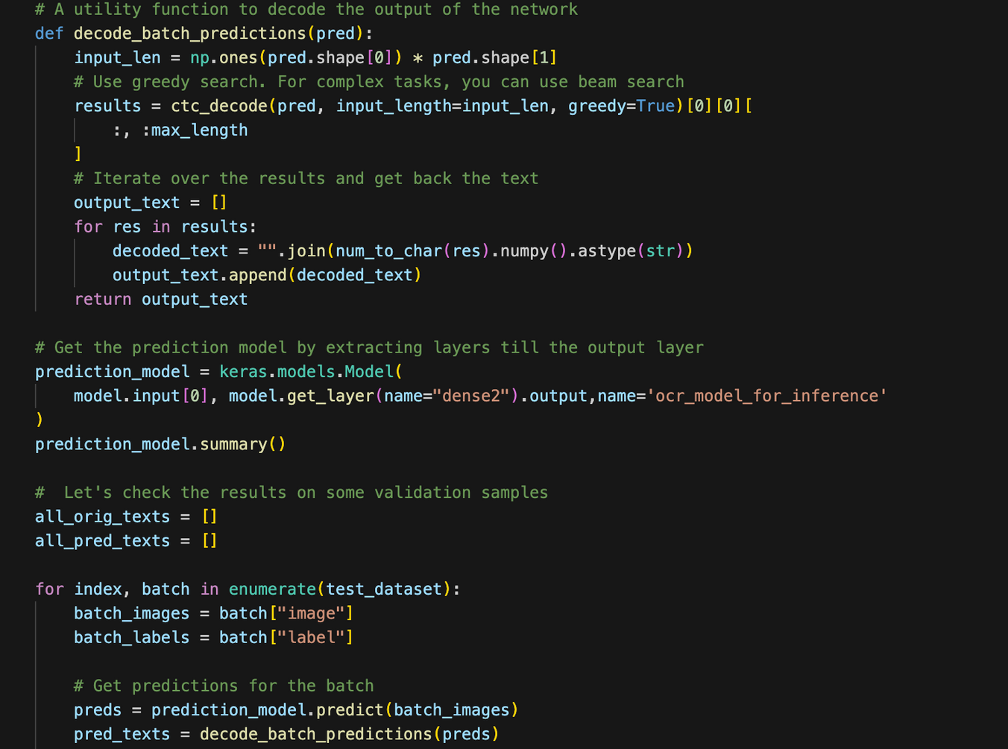
PURPOSE: Takes the raw model predictions and uses the ctc_decode function to convert them back into human-readable text.
INSIDE THE LOOP:
PREDICTS text from images, DECODES predictions to human readbale texts and compares predicted text to true text
VISUALISES the first batch's images alongside predicted and true text.
This visualization and comparison are crucial for understanding the model's performance and debugging issues in the OCR process, such as characters being misread or skipped.
Notes:
14

Slide 18
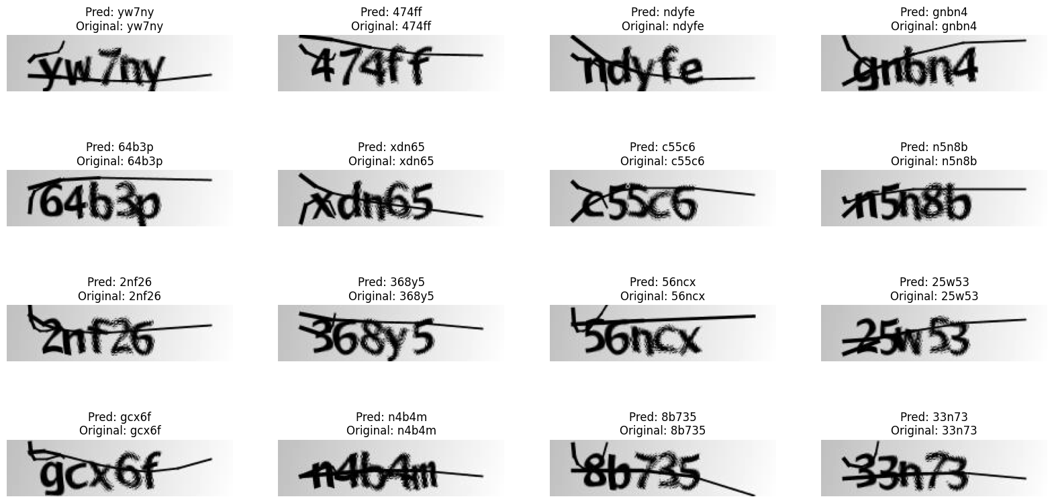
RESULT
This is our output for first batch of our test data.
Accuracy for the entire test dataset comes out to be 97.68%.
Notes:
14

Slide 19
POTENTIAL APPLICATIONS
Text Extraction from Images
Automated Data Entry
By integrating the OCR model, text may be extracted from images taken using cameras or mobile devices. This makes activities like scanning business cards, and extracting text for analysis or translation from photographs easier.
By automatically extracting text from images, the OCR model can significantly reduce manual data entry efforts in various fields, leading to improved accuracy and efficiency in data processing tasks.
Document Digitization
The OCR model can be used to convert scanned documents, such as contracts, invoices, and receipts, into editable and searchable digital formats, streamlining document management and retrieval processes.
Notes:
19

Slide 20
References:
[1] Text Recognition in Multimedia Documents: A Study of Two Neural-based OCRs Using and Avoiding Character Segmentation
Link:
https://www.researchgate.net/publication/235665033_Text_Recognition_in_Multimedia_Documents_A_Study_of_two_Neural-based_OCRs_Using_and_Avoiding_Character_Segmentation
[2] Segmentation-free connectionist temporal classification loss-based OCR model for text captcha classification
Link : https://arxiv.org/pdf/2402.05417.pdf
Notes:
19

Slide 21
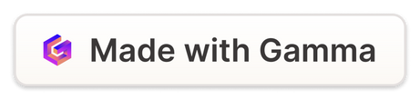
THANK YOU
Notes:
22

